Slide 1
CLUB ASSEMBLY
JULY 6, 2021
Notes:
In November 2020, Karen formed a committee to prepare a 5-year strategic plan. She named Andy, Chuck, George, Norma, and me with Karen as an ad hoc member. I volunteered to chair the committee. For the next three months, we met pretty much weekly. We created the plan in an Excel spreadsheet and in this Powerpoint version for communication to the Board and general membership.

Slide 2
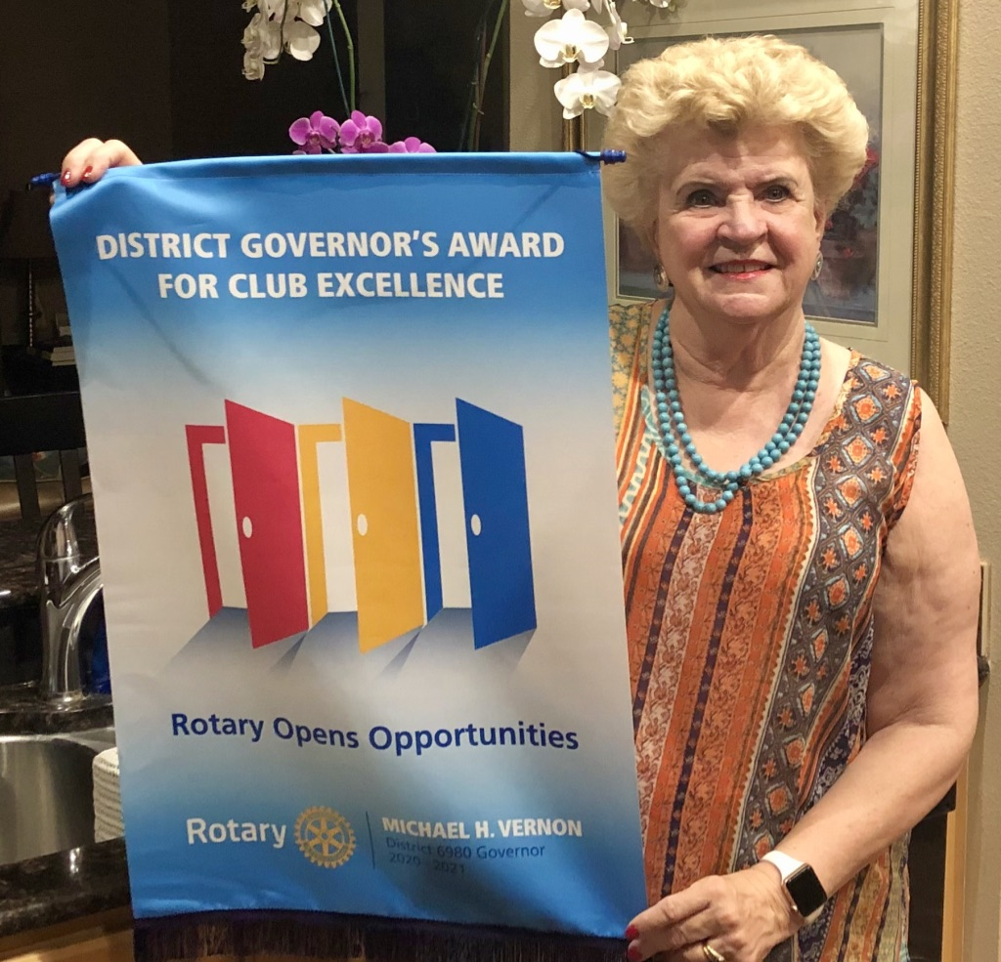
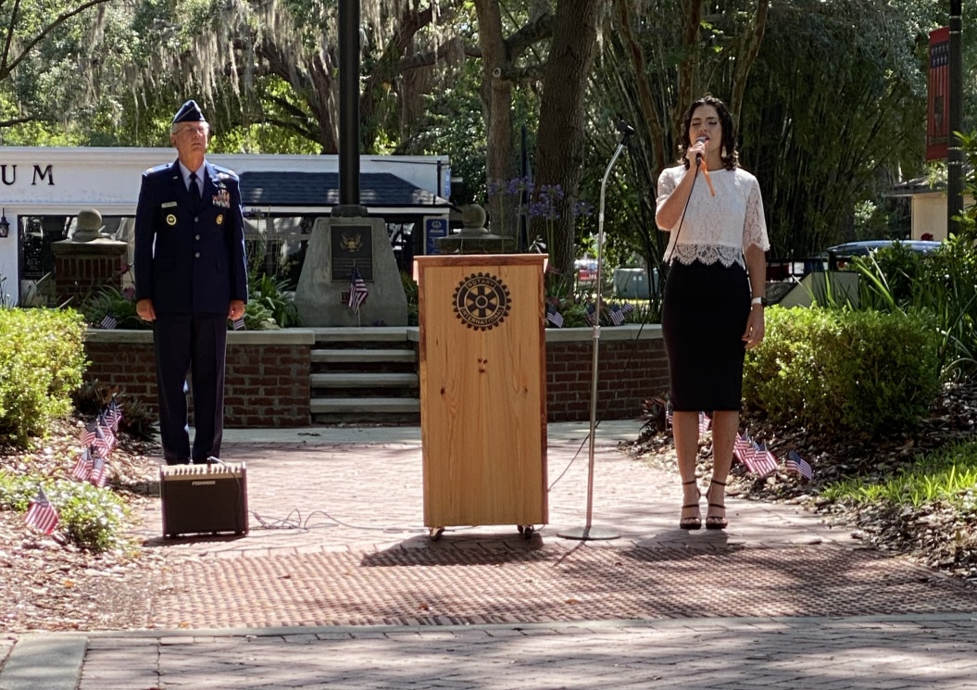
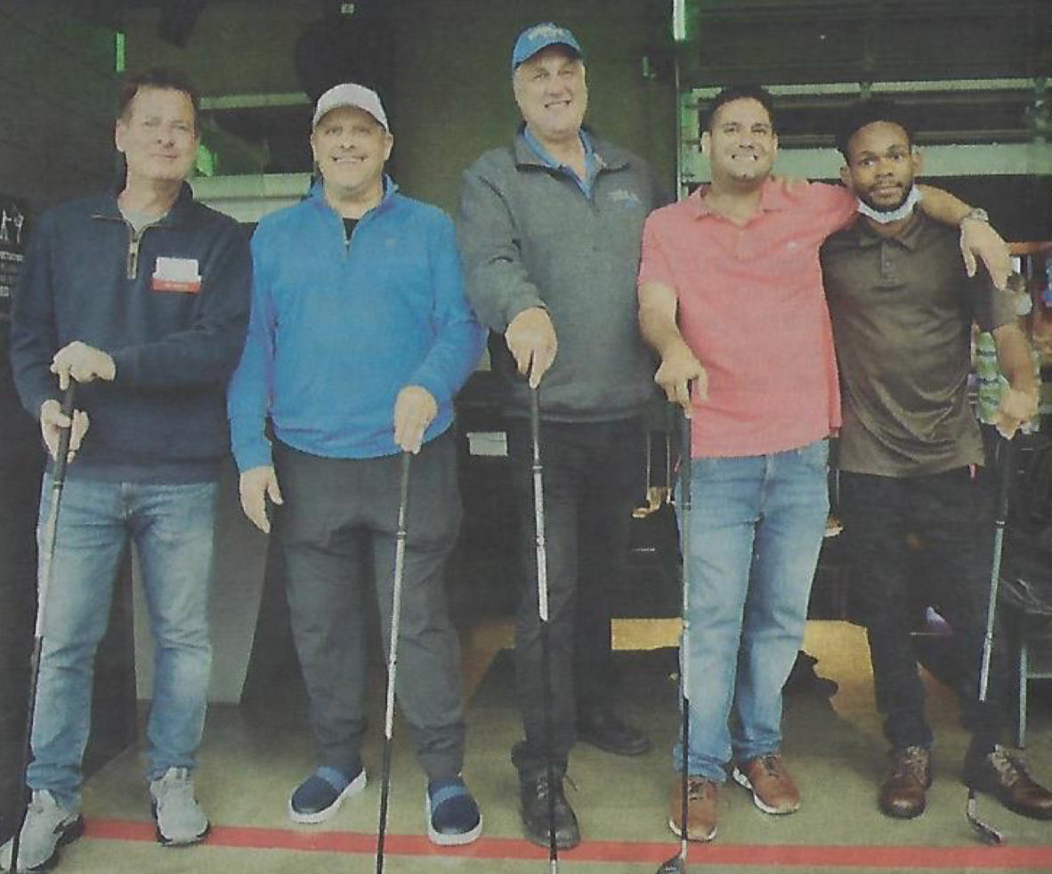
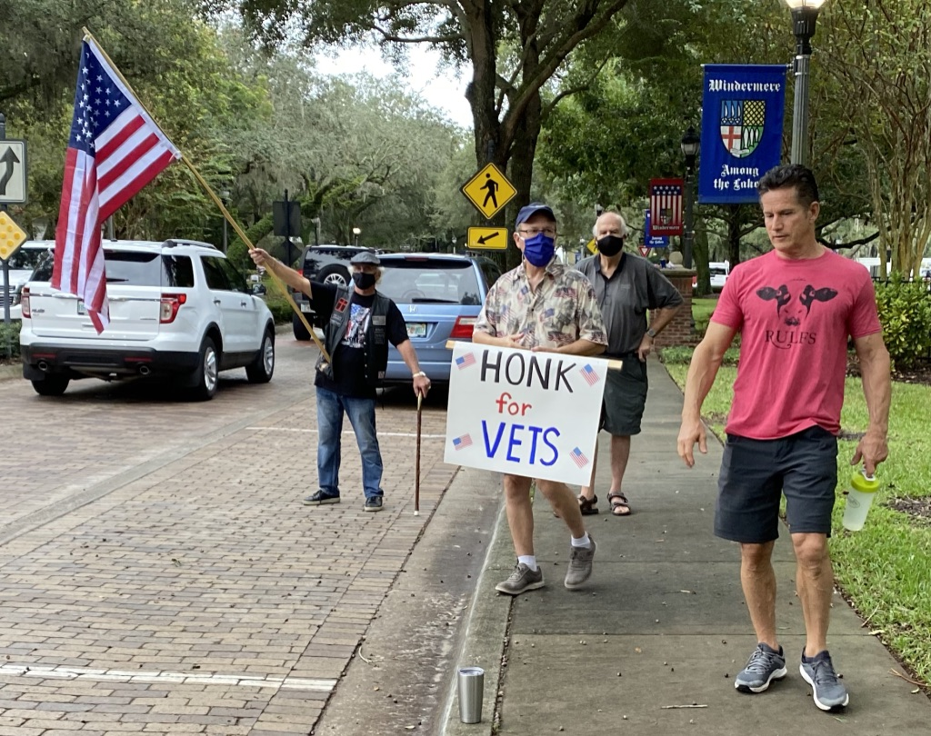
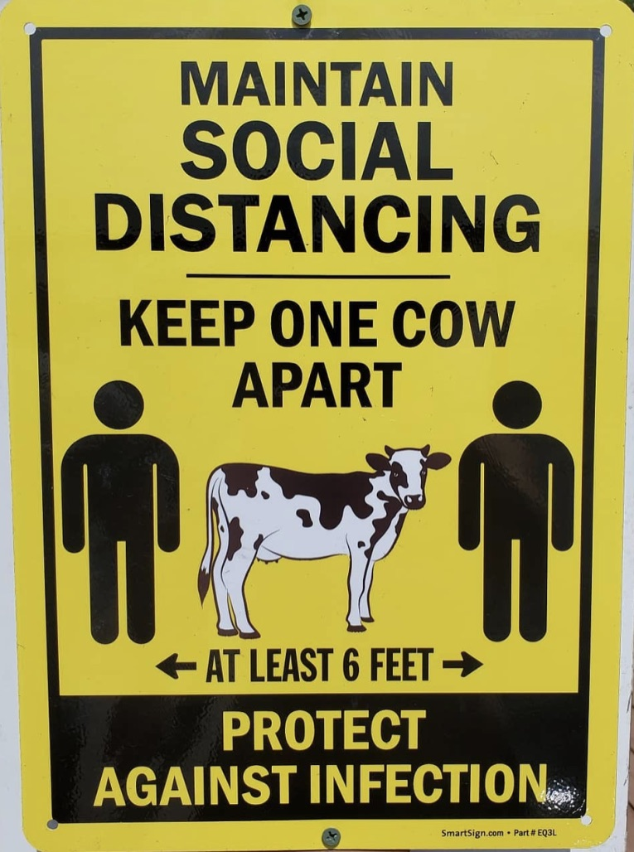
2020-2021 HIGHLIGHTS AND ACCOMPLISHMENTS KAREN HAIRSTON
Veterans Day & Memorial Day events
4-Way Test essays
Scholarships
Edgewood Ranch fun day
Meals-on-Wheels
Tripled Foundation support
2 Topgolf fundraisers
Orlando Health sponsorship
Zoom and Hybrid meeting success
7 New members
First Corporate members
Satellite club initiative
5-Year Strategic Plan
Bylaws etc. updates
$1M Pavilion grant & agreements
Notes:
Under each Major Goal, we defined measurable Objectives and Actions, with each one being measurable and trackable and further detailed in clearly defined action steps.
We said we were going to add 5 new members per year through a structured process like Andy has put together as Membership Chair. We said we were going to do that in three ways: structured outreach, getting all our members involved, and engaging community officials.
We set objectives for fundraisers – what we do, how we do it.
We set objectives to engage, promote, and recognize people who make major contributions to our community.
We also set an objective to build relationships with potential sponsors.
Take-away: Through these initiatives we will grow, do more, be more visible, and find ways for other people and other organizations to join with us. By better serving the community, we will have more impact.

Slide 3
SECRETARY’S REPORT CHUCK BARCUS
Club Administration - The primary role of the Club Secretary is to facilitate the Club’s Administrative functions.
Governance - This year the Club updated the Club Constitution, By-Laws, and Policies. Changes include our new lunch time satellite Club, creation of Corporate Memberships, and incorporating other recent changes by Rotary International.
Establishment of Goals - The Club created a 5-Year Strategic Plan to increase the size, impact, and image of our Club.
Managing Club Membership: To facilitate membership growth, the Secretary developed checklists for adding, deleting, or reinstating members. The Secretary also developed training for new members on the purpose and use of the Rotary websites.
Timely Communications: This year there has been timely distribution of Board Minutes to the Board Members and the general membership. Member communications now include sending birthday, sympathy, and get well cards.

Slide 4
TREASURER’S REPORT PHIL LEOPOLD
We have a solid financial position.
Fundraising and Service are at stable amounts.
Fund | 2019 | 2020 | 2021
Operating | $25,400 | $22,773 | $20,195
Service | $35,000 | $51,767 | $48,936
Fiscal Year | Funds Raised | Service Expenditure
2018 -19 | $19,718 | $14,168
2019 - 20 | $22,773 | $16,947
2020 - 21 | $17,959 | $19,034
Funds in the bank at June 30.
2021-2022 Club Operating Budget balances with $15/Quarter dues increase.
2021-2022 Service Budget is being developed.

Slide 5
OUR MISSION
Service Above Self, fulfilling needs at home
and abroad through friendship and working
together.
Notes:
We felt that we should agree on what our mission is as a club, our vision of how we want ourselves and others to perceive the club, and a brief punchy saying, like Service Above Self. This is what we came up with. We struggled most coming up with a mantra and theses are some of the others we considered.

Slide 6
OUR VISION
The Rotary Club of Windermere is a
prominent, effective, respected,
and influential contributor to the welfare and
quality of life in our community.
Notes:
We felt that we should agree on what our mission is as a club, our vision of how we want ourselves and others to perceive the club, and a brief punchy saying, like Service Above Self. This is what we came up with. We struggled most coming up with a mantra and theses are some of the others we considered.

Slide 7
CLUB STRUCTURE, GUIDANCE, RESOURCES
CONSTITUTION
BYLAWS
POLICY AND PROCEDURES
DISTRICT SUPPORT STAFF, RLI, WEBSITES
LEADERSHIP MANUALS & COURSES FROM ROTARY INTERNATIONAL
5-YEAR STRATEGIC PLAN
BOARD OF DIRECTORS
ALL MEMBERS’ IDEAS, ENERGY, AND ENGAGEMENT
Notes:
Under each Major Goal, we defined measurable Objectives and Actions, with each one being measurable and trackable and further detailed in clearly defined action steps.
We said we were going to add 5 new members per year through a structured process like Andy has put together as Membership Chair. We said we were going to do that in three ways: structured outreach, getting all our members involved, and engaging community officials.
We set objectives for fundraisers – what we do, how we do it.
We set objectives to engage, promote, and recognize people who make major contributions to our community.
We also set an objective to build relationships with potential sponsors.
Take-away: Through these initiatives we will grow, do more, be more visible, and find ways for other people and other organizations to join with us. By better serving the community, we will have more impact.

Slide 8
YOUR LEADERSHIP TEAM 2021-2022
BOARD POSITIONS | MEMBER SERVING (Yrs. in Rotary)
President* | Frank Krens (7)
Immediate Past President* | Karen Hairston (4) Past Pres.
President-Elect* | George Poelker (18)
Secretary* | Chuck Barcus (2)
Treasurer* | Phil Leopold (4)
Membership | Andy Agoos (3)
Public Relations | Steve Simoneaux (<1)
Foundation | Byron Sutton (52) Past Pres.
International Service | Emerson Greco (16) Past Pres.
Youth Service | Norma Sutton (33) Past Pres.
Club Service | Judy Black (27)
Vocational Service | Don Hairston (44) Past Pres.
NON-BOARD POSITIONS | MEMBER SERVING
Bulletin | Norma Sutton
Sergeant-at-Arms | Spencer Saintfleur (2)

Slide 9
MAJOR GOALS 5-Year Strategic Plan
INCREASE OUR IMPACT
EXPAND OUR REACH
STRENGTHEN OUR IMAGE / REPUTATION
ENHANCE PARTICIPANT ENGAGEMENT
IMPROVE OUR KNOWLEDGE OF ROTARY
Notes:
We looked at different ways to structure the plan and decided to follow the approach used by Rotary International in their plan. RI chose four Major Goals as the first level: 1. Increase our impact, 2. Expand our reach, 3. Strengthen our image / reputation, and 4, Enhance Participant Engagement. We chose one more, Improve our knowledge of Rotary.

Slide 10
GROW, DO MORE, BE MORE VISIBLE
Structured and focused recruiting
Fundraisers – raise at least $15,000 per year
Corporate sponsorship and recognition
Pavilion
Notes:
Under each Major Goal, we defined measurable Objectives and Actions, with each one being measurable and trackable and further detailed in clearly defined action steps.
We said we were going to add 5 new members per year through a structured process like Andy has put together as Membership Chair. We said we were going to do that in three ways: structured outreach, getting all our members involved, and engaging community officials.
We set objectives for fundraisers – what we do, how we do it.
We set objectives to engage, promote, and recognize people who make major contributions to our community.
We also set an objective to build relationships with potential sponsors.
Take-away: Through these initiatives we will grow, do more, be more visible, and find ways for other people and other organizations to join with us. By better serving the community, we will have more impact.

Slide 11
REACH BEYOND TOW
Neighboring developments
Corporate Membership
Satellite Club at Health Central
Interact parents
Rotoract
Student exchange
Notes:
Under each Major Goal, we defined measurable Objectives and Actions, with each one being measurable and trackable and further detailed in clearly defined action steps.
We said we were going to add 5 new members per year through a structured process like Andy has put together as Membership Chair. We said we were going to do that in three ways: structured outreach, getting all our members involved, and engaging community officials.
We set objectives for fundraisers – what we do, how we do it.
We set objectives to engage, promote, and recognize people who make major contributions to our community.
We also set an objective to build relationships with potential sponsors.
Take-away: Through these initiatives we will grow, do more, be more visible, and find ways for other people and other organizations to join with us. By better serving the community, we will have more impact.

Slide 12
ENGAGE WITH AND APPRECIATE THE COMMUNITY
Digitally - Public exposure via news and social media
In person - Veterans Day-like experiences
Hands on - Service projects (vs fundraising projects)
Gratitude - Sponsors’ and community recognition
Ethics - 4-Way Test and vocational promotion
Notes:
We looked at how we are viewed by the community and what we can do to make that better.
We can get the word out through social media and other means when we do something good.
We can show up together in public as we did on Veterans Day.
We can do more service projects like the upcoming Edgwood picnic.
We can recognize and promote our sponsors and contributors publicly.
We saw the 4-Way test as a vehicle to involve more people and possibly to solicit sponsorship.
Take-away: We want to use the tools and opportunities available to use to show ourselves to the community in the best light.

Slide 13
MAKE IT EASIER AND MORE REWARDING FOR MEMBERS AND OTHERS TO SERVE
Parties, socials, celebrations, honoring
Volunteer opportunities for Interact students and members
Corporate sponsorship, business participation & recognition
Notes:
Our Board members and a few others are engaged. We think we can do better by encouraging every member to serve on a committee and by asking members to sign up for duties during meetings and events.
We think we can engage more with the Interact clubs – get their ideas, provide volunteer opportunities, help them plan their year. Include them in our events.
We envision every local business to engage with Rotary in some way – large or small. As a financial sponsor, or just a friend or Rotary.
Everybody likes to be appreciated. We can express our appreciation in many ways. One way is to include an appreciation moment in our regular meetings.
Take-away – Most people will respond if asked and want to know their efforts are appreciated. So it’s largely about please and thank you.

Slide 14
LEARN AND SHARE THE KNOWLEDGE, RESOURCES, AND CULTURE OF SERVICE THAT ARE ROTARY
Rotary Leadership Institute and all District activities & resources
Other local clubs
Fellowship clubs
Each other and our vocations
Rotary Foundation
Notes:
We know that learning more about Rotary through the RLI makes better members and members that stay.
We would encourage all Board members to attend RLI.
Invite District leaders to speak at our meetings.
Highlight District events in the Roundabout and in our meetings, and
Provide training on District and International websites.

Slide 15
COMMITTEE PLANS

Slide 16
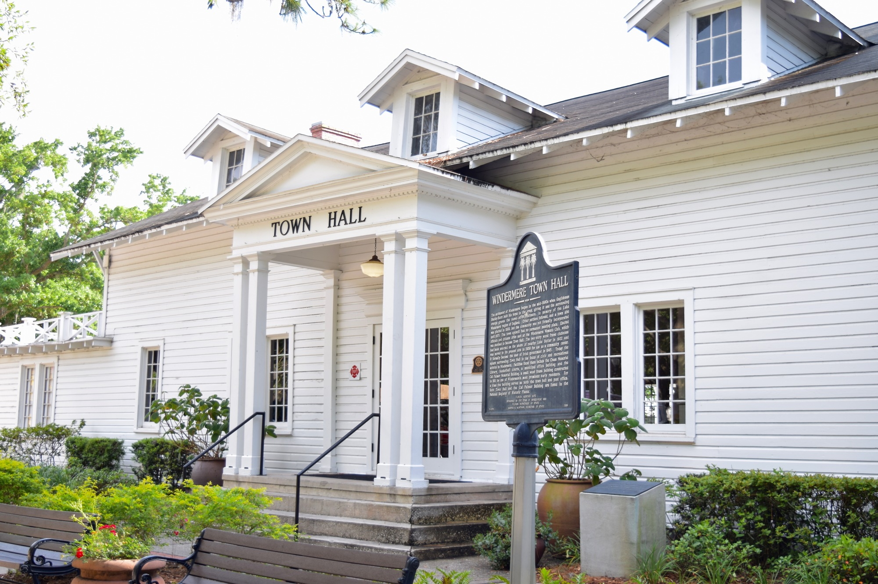
Public Relations Plan
Integrate a membership program into the Strategic Plan
Increase public visibility into our events and causes.
Pavilion Updates in multiple media outlets
Introduce Rotary to more local high-profile folks and businesses

Slide 17
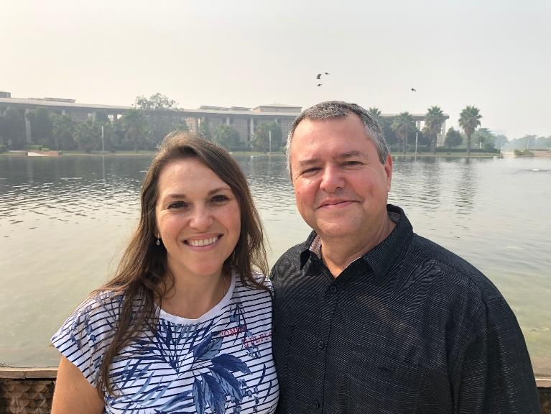
MEMBERSHIP COMMITTEE PLAN ANDY AGOOS
Repeat Outreach Initiatives used in 2020-2021, chaired as follows:
Former members Rich Carbone
Hospitality Gregg Anderson
New residents George Poelker with Judy’s help
Young adults Janet James Mahon
TOW gov’t & businesses Stephen Withers
Satellite Club/Orlando Health Don Hairston
Add 3 Outreach Initiatives for 2021-2022: chaired as follows:
Nextdoor.com app Regiane and Francisco Cidral
Veterans Paul Kenard
Corporate members Don and Karen Hairston
Deputy Chairs Still TBD
Saying from Bill Gates: “If you want to travel fast, go alone. If you want to travel far, go together.”

Slide 18
FOUNDATION COMMITTEE PLAN BYRON SUTTON
Peace and conflict prevention/resolution
Disease prevention and treatment
Water and sanitation
Maternal and child health
Basic education and literacy
Economic and community development
The Environment
Foundation Grants

Slide 19
FOUNDATION
Chair Byron Sutton Current Committee needs 2 more members
Action Items for Committee to Accomplish
Convert every member to become sustaining member at $25 per quarter as this increases Paul Harris Fellows and increases our DDF which is used for scholarships for students
Foundation has 7 areas of focus – present Rotary moments of success on each area over the year
Plan Polio Day Presentation in October
Invite District Foundation Chair to meeting
Develop quiz questions to use at each meeting to increase knowledge of Foundation

Slide 20
INTERNATIONAL COMMITTEE PLAN EMERSON GRECO
DEVELOP PROJECTS IN UNDERSERVED AREAS
PARTNER WITH LOCAL ROTARY CLUBS
PRIORITIZE ROTARY FOCUS AREAS

Slide 21
YOUTH SERVICES COMMITTEE PLAN NORMA SUTTON
Current Committee Members: Janet James Mahon & Karen Hairston
- Would like to recruit 2 more members
Interact Clubs
Communicate with Interact faculty sponsor & Interact members at beginning of school year
Attend meetings bi-monthly at each school and ask for report for bulletin each month
Ask clubs to adopt year long project (for example, collecting plastic caps to recycle to support military)
Ask for parents email address and use to circulate bulletin, invite to events, attend Rotary meetings
Promote summer student exchange and have attendees at RYLA
Promote scholarship program (budget $6000 for the year)
4 Way Test
Enhance 4 Way test at each school
Use PR to submit report on topic and pictures of winners
Consider reinstituting the “Golden Ruler” as gift
Solicit sponsors for each school for the test with recognition plaque and in articles
Add more schools

Slide 22
CLUB SERVICE COMMITTEE PLAN JUDY BLACK
Responsibilities
- Food service
- Roundabout
- Club events
Encourage Member Engagement
- Solicit members for new ideas
- Do something different each year.

Slide 23
VOCATIONAL SERVICE COMMITTEE PLAN DON HAIRSTON
Concept of Vocational Service
Encourage and foster:
High ethical standards in business and professions.
Recognition of worthiness of all useful occupations.
Dignifying of each Rotarians occupation as an opportunity to serve society
Opportunities/Action Plan
Talk about your vocation in your club, and take time to learn about fellow members vocations – Prepare a “book” describing each members profession, and make available for all members
Use your professional skills to serve your community –
Support Rotary District initiative “Rotary Means Business”
Practice your profession with integrity – 4 way test
Help a young person achieve his/her career aspirations – Support Youth Services with presentations to Interact Clubs with questions and answers about vocations
Guide and encourage others in their professional development – Develop a mentoring program pairing a Rotary member with an Interact member who has similar vocational interests.

Slide 24
PRESIDENT-ELECT PLANS GEORGE POELKER
Community Leader Outreach
Invite community leaders to speak, join and/or partner.
Strive for at least 1 community leader speaker per quarter.
Guidance for Events
Learn from successful past events.
Develop generic guidance for future events.
Celebration
Recognize one member for contribution / participation during each meeting.
Recognize community leaders
Invite members of neighbor clubs to be guest speakers at our meetings.

Slide 25
SPEAKER / PRESENTATION FOCUS AREAS TOM JOHNSON
JULY A NEW YEAR: CLUB GOALS AND OBJECTIVES
AUGUST MEMBERSHIP, BENEFITS OF JOINING ROTARY
SEPTEMBER LITERACY
OCTOBER ECONOMIC DEVELOPMENT
NOVEMBER ROTARY FOUNDATION
DECEMBER DISEASE PREVENTION AND TREATMENT
JANUARY VOCATIONAL SERVICE, 4-WAY TEST, CAREER GUIDANCE
FEBRUARY WORLD UNDERSTANDING, ECONOMICS, PEACE
MARCH WATER AND SANITATION
APRIL MATERNAL AND CHILD HEALTH
MAY NEW GENERATION / YOUTH SERVICES
JUNE ROTARY FELLOWSHIP

Slide 26
SPEAKERS AND MEETING SCHEDULE FOR JULY TOM JOHNSON
July 6 Club Assembly Frank Krens, President Hybrid, Town Hall
July 13 Neuroscience Dr. Francisco Cidral Hybrid, Town Hall
July 19 Board Meeting
July 20 District News Barry Gainer, District Gov. Hybrid, Town Hall
July 26 Monday night happy hour Burntwood

Slide 27
QUESTIONS / DISCUSSION

